Slide 1
STATS FOR BUSINESS ANALYTICS
Project Title : Data Analysis of Different Cars from Car Dekho Website
Team Members :
Sai Lokesh Siddanathi
Kiran Kore

Slide 2

Agenda
Objective
Data
Data Cleaning
Regression Analysis
Time-Series Forecast
Conclusion

Slide 3

Objective
The goal of this research is to create algorithms that anticipate automotive selling prices.

Slide 4
Attributes
Name : Name of the car
Brand : Producer of the car
Type : Version of the car
Selling price : Selling Price of the car
Km driven : Kilometres driven by the car
Fuel type : Type of the Fuel
Seller type : Seller who is individual or Dealer
Transmission : Automatic/Manual
Owner : Number of previous owner of the car

Slide 5
Data Cleaning and Transformation ​ ​ To Perform Data cleaning and Transformation operations​ ​ 1) Check the Duplicate values ​ 2) Check the NA values​ 3) Missing data was replaced by Mean/Averages

Slide 6
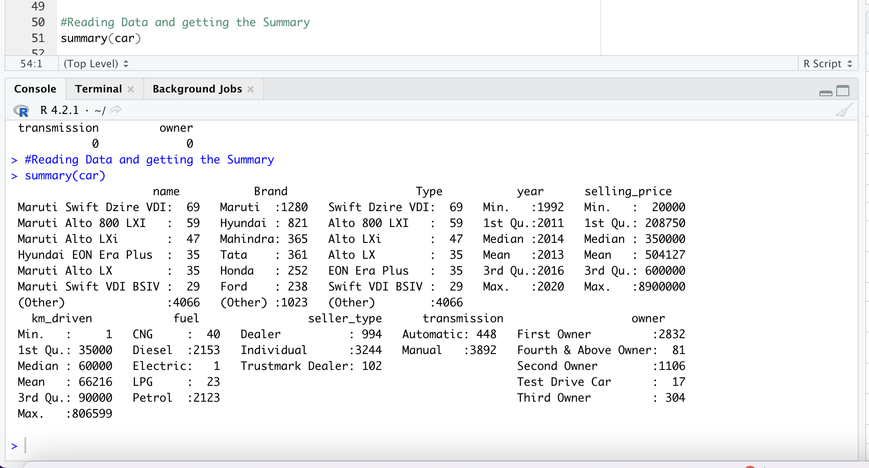
SUMMARY

Slide 7
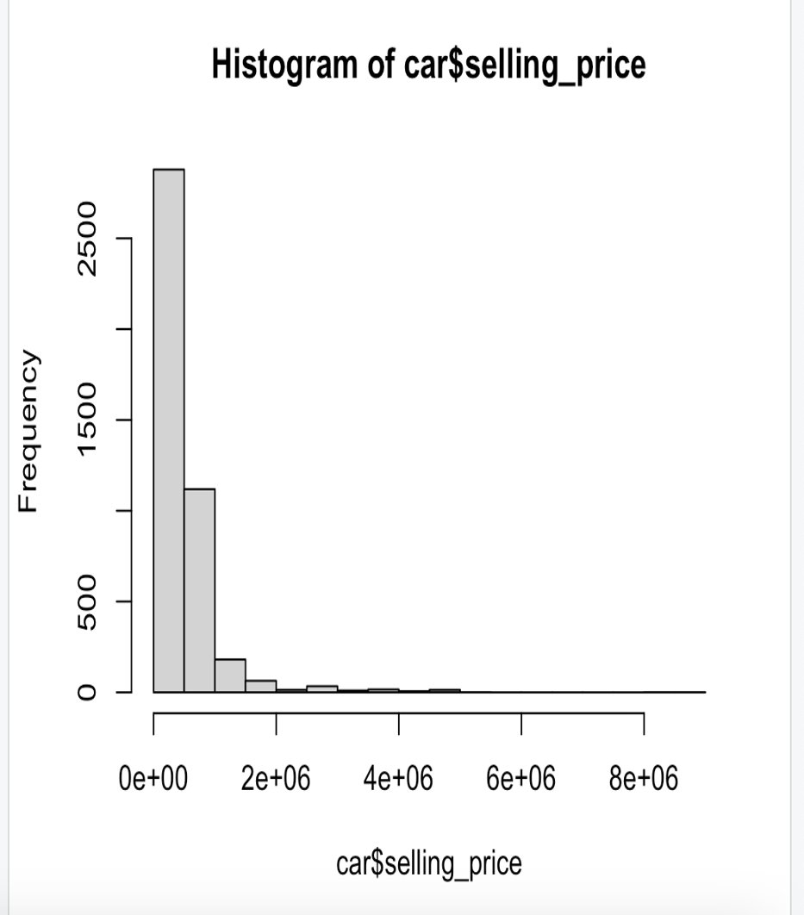
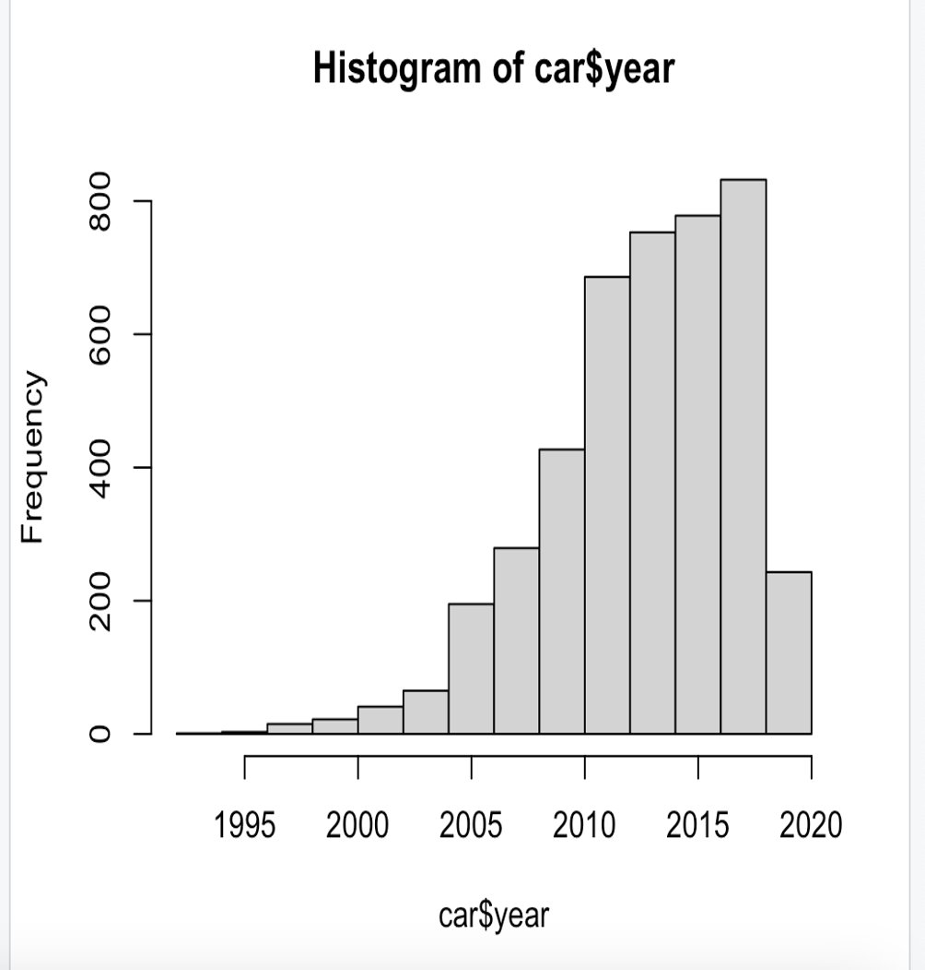
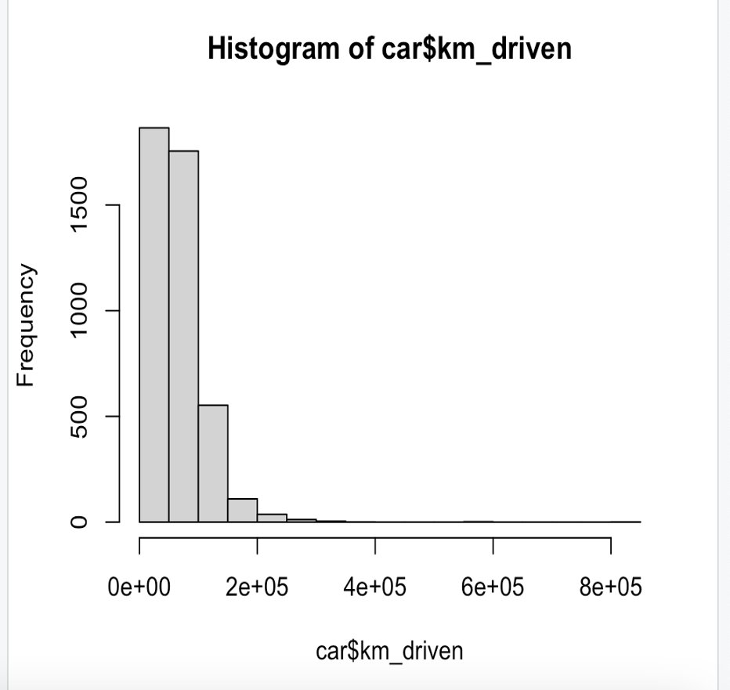
Checking if dependent variable follows a Normal Distribution

Slide 8
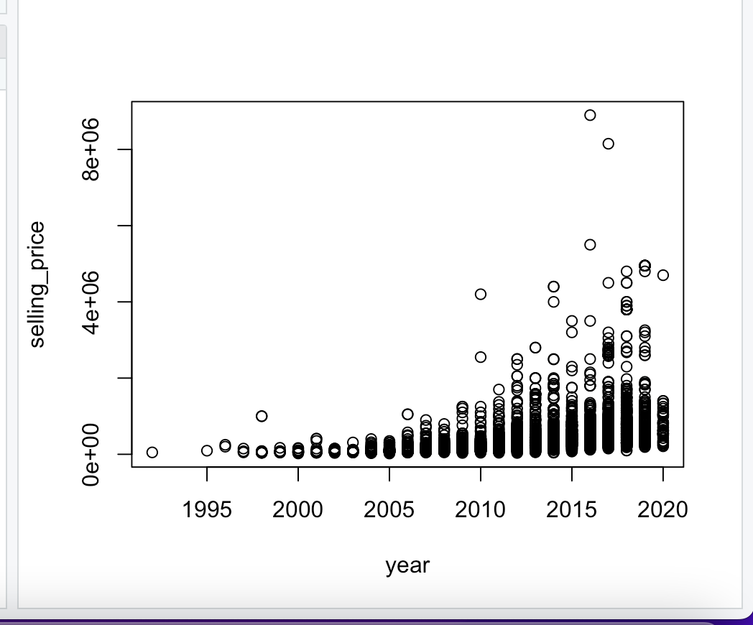
LINEARITY CHECK

Slide 9
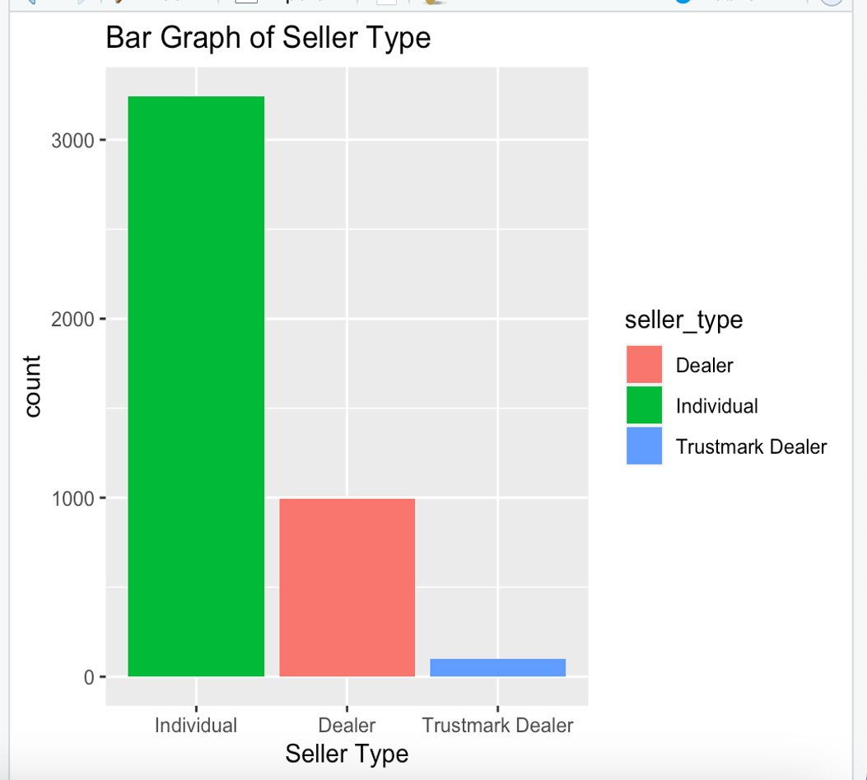
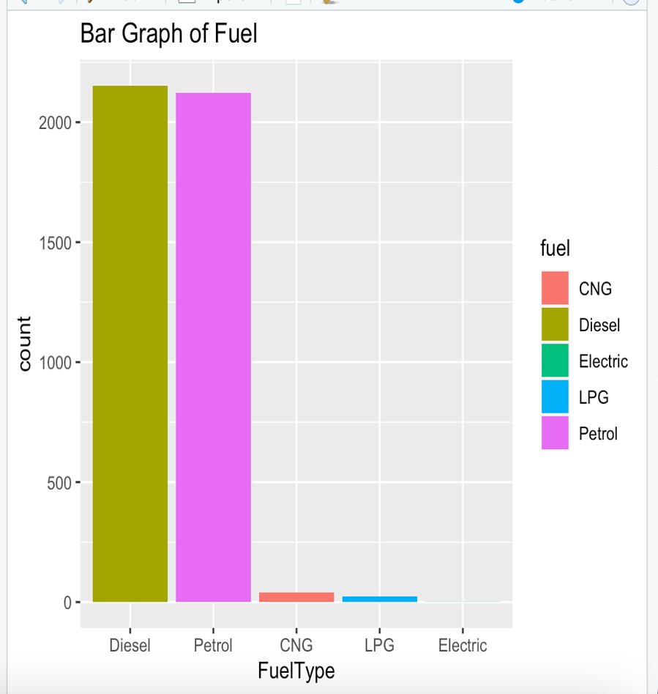
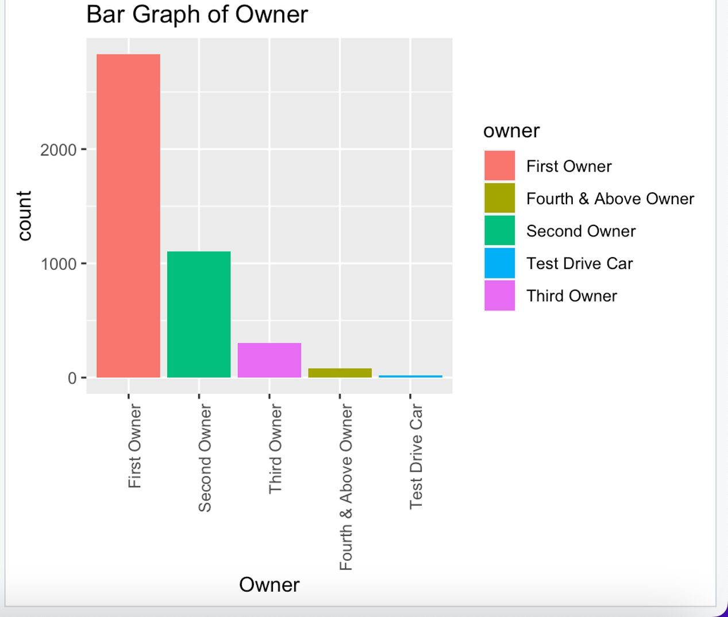

Slide 10
REGRESSION ANALYSIS
LINEAR REGRESSION
MULTIPLE LINEAR REGRESSION
SIMPLE REGRESSION

Slide 11
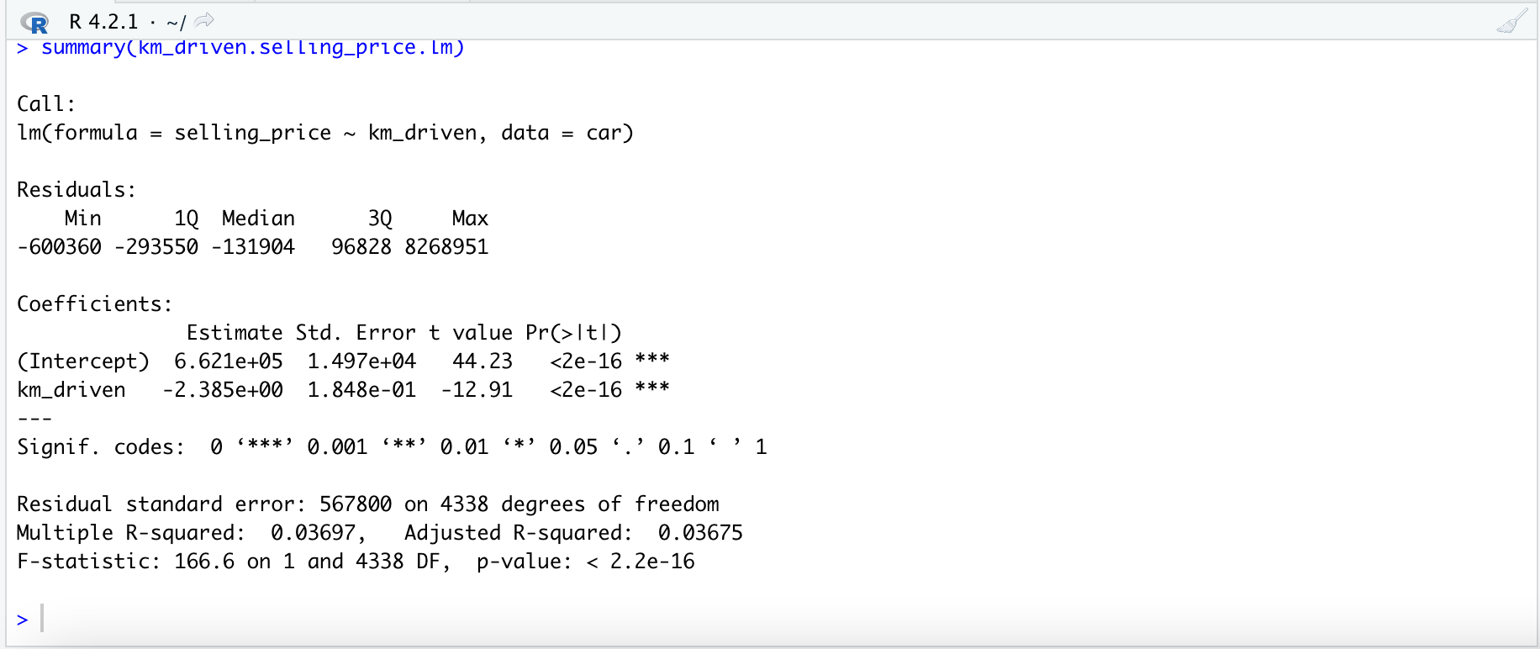
Linear Regression

Slide 12
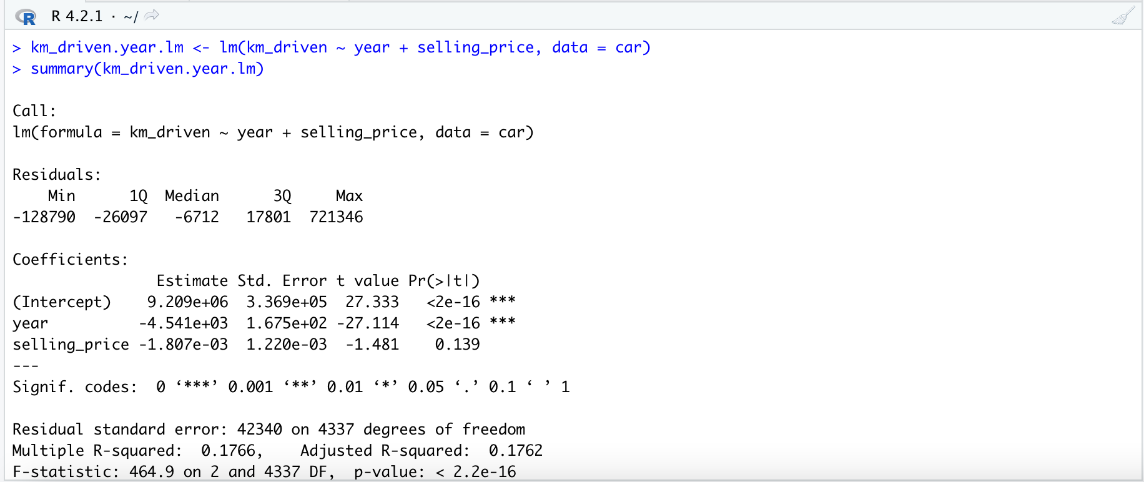
MULTIPLE Linear Regression

Slide 13
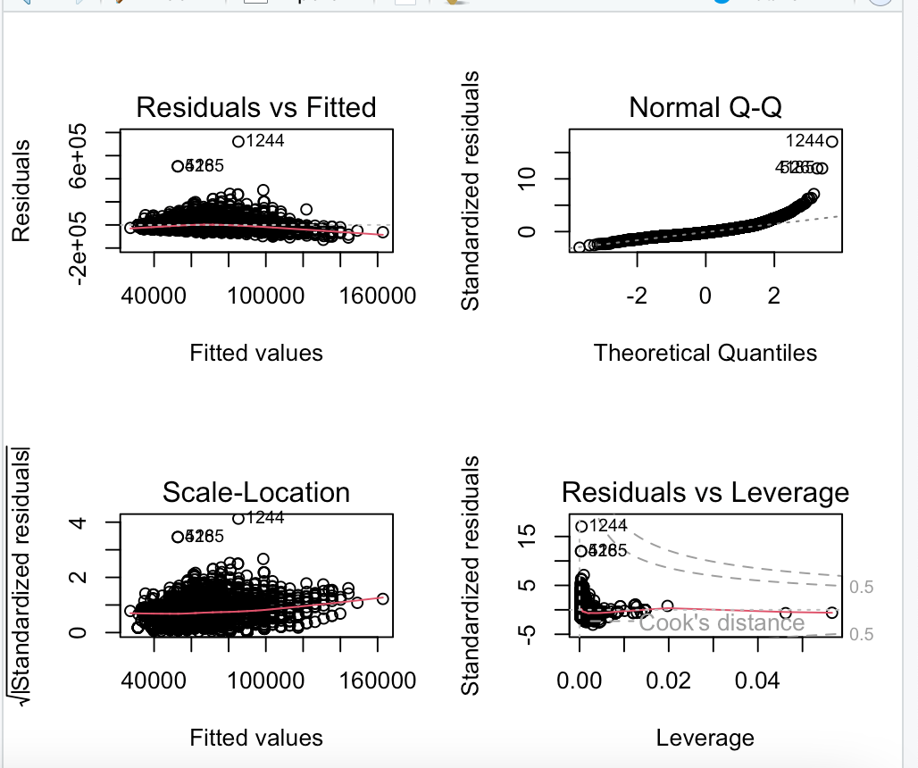
GOOD FIT OR NOT

Slide 14
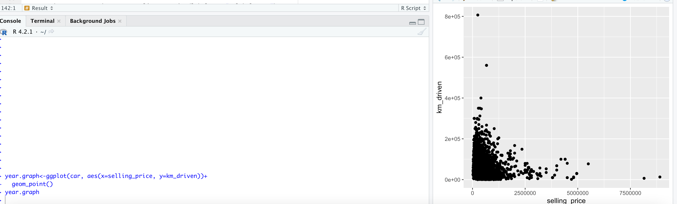
SIMPLE REGRESSION

Slide 15
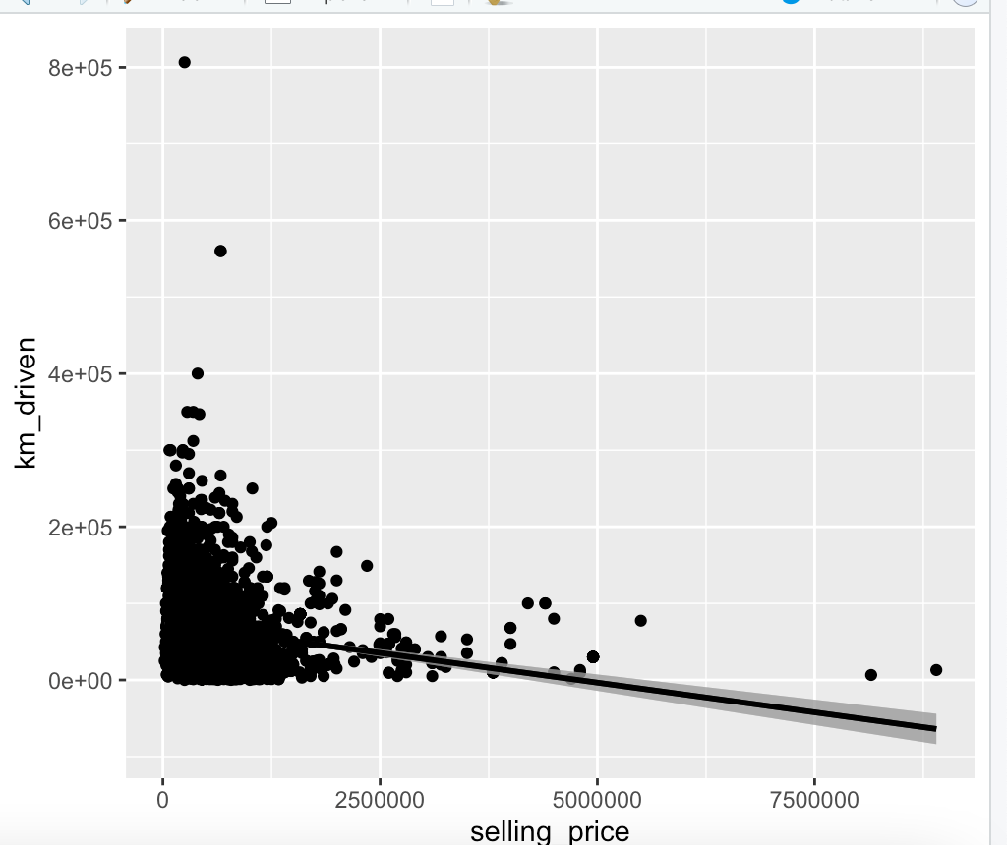
LINEAR REGRESSION LINE

Slide 16
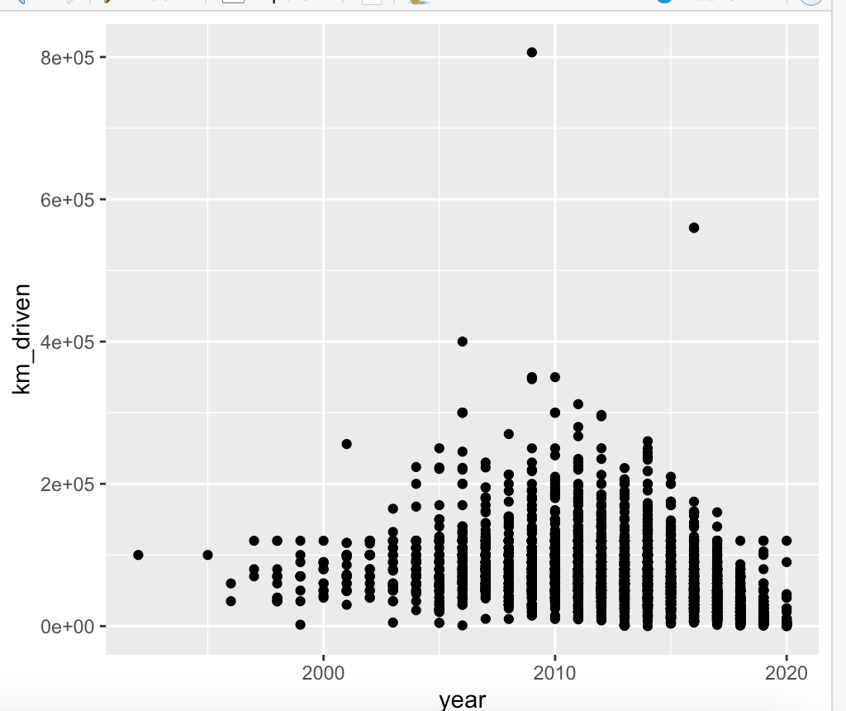
Price variation with kilometers driven

Slide 17
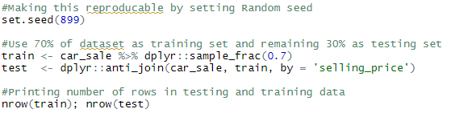
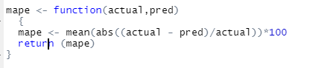
TIME SERIES FORECAST
Mean Absolute Percentage Error (MAPE):

Slide 18
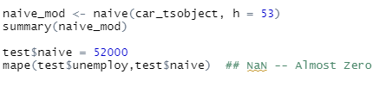
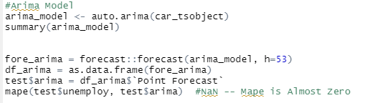
Naïve Forecast
ARIMA Model

Slide 19
Timeline
1st Phase
Data Collection and understanding about the dependent and independent variables
2nd Phase
Data Transformation and Data Cleaning
Like removing duplicates and NA values
3rd Phase
Data Analysis using linear , multiple and simple regression
4th Phase
Time series forecast .
5th Phase
Report and presentation

Slide 20



Conclusion
Maruti being top Notch selling car
Manual type of transmission sell more than Automatic​
More sales are observed in new car models​
In the year 2017 sales numbers are high ​
Petrol and Diesel mode of fuel sales are high​

Slide 21




Thank you

